Slide 1
GENERATIVE AI Final Project
Name: : YOGESHWARAN V N
Register Number : 513121104048
Department : B.E Computer Science and Engineering
Year / Semester : III Year / VI Semester
College Name : Thanthai periyar Governmet Institute of
Technology, Vellore - 632002

Slide 2
PROJECT TITLE
IMAGE COLOURIZATION USING GAN

Slide 3
AGENDA
Problem Statement
Project Overview
Who are the End Users?
Solution and its Value Proposition
The WOW in My Solution
Modelling
Algorithm and Deployment
Result
Conclusion
References

Slide 4
PROBLEM STATEMENT
Develop a generative adversarial network (GAN) system capable of colorizing black and white images efficiently without belonging to a specific class of objects. Utilizing a Conditional Generative Adversarial Network (CGAN), the system should accept one-channel images of fixed dimensions (32x32 pixels) as input and generate corresponding colored images of the same size. The challenge lies in training the network to produce realistic and diverse colorizations for a wide range of images depicting various subjects, including animals, vehicles, and scenes, among others.

Slide 5
PROJECT OVERVIEW:
The project aims to develop a generative adversarial network (GAN) system capable of colorizing black and white images efficiently. Leveraging the Conditional Generative Adversarial Network (CGAN) architecture, the system takes grayscale images as input and generates corresponding colored images. This solution addresses the need for automated image colorization, which finds applications in various domains such as photography, image editing, and historical image restoration.

Slide 6
WHO ARE THE END USERS?
The end users of this project include:
Photography enthusiasts: Individuals seeking to enhance old or grayscale images with vibrant colors.
Graphic designers: Professionals requiring efficient tools for image manipulation and enhancement.
Historians and archivists: Those interested in restoring historical black and white photographs for preservation and documentation purposes.

Slide 7
SOLUTION AND ITS VALUE PROPOSITION:
Utilize a Conditional Generative Adversarial Network (CGAN) architecture to implement a system capable of colorizing black and white images efficiently.
Employ a generator model to transform one-channel black and white images of fixed size (32x32 pixels) into corresponding colored images of the same size.
Implement a discriminator model to distinguish between real colored images and generated colored images.
Train the CGAN system iteratively to optimize the generator and discriminator networks simultaneously.

Slide 8
VALUE PROPOSITION:
Time-saving: Eliminates the need for manual colorization, enabling quick and effortless enhancement of images.
Quality enhancement: Produces realistic and visually appealing colorizations, enhancing the overall quality of images.
Versatility: Capable of colorizing images depicting various subjects, including but not limited to animals, vehicles, and landscapes.
Accessibility: Offers a user-friendly interface for easy utilization by individuals with varying levels of technical expertise.

Slide 9
THE WOW IN MY SOLUTION:
The standout feature of this solution lies in its ability to produce high-quality colorizations without belonging to a specific class of objects. Unlike traditional methods limited to certain image categories, our system efficiently colorizes a wide range of images, ensuring versatility and applicability across diverse domains. Additionally, the integration of the CGAN architecture allows for the generation of realistic and diverse colorizations, further enhancing the wow factor of the solution.

Slide 10
MODELLING
Data Preparation:
Load the CIFAR-10 dataset which contains labeled images belonging to various categories.
Convert the RGB images to grayscale by averaging the pixel values across the color channels.
Generator Network:
Construct a generator model that takes grayscale images as input and produces colorized images as output.
Design the generator using a series of convolutional and deconvolutional layers with batch normalization and ReLU activation functions.

Slide 11
Discriminator Network:
Develop a discriminator model to differentiate between real colored images and generated colorized images.
The discriminator is composed of convolutional layers followed by fully connected layers, with batch normalization and LeakyReLU activation functions.
Training:
Train the generator and discriminator networks alternately in a minimax fashion.
Optimize the networks using the Adam optimizer with binary cross-entropy loss.
Update the discriminator multiple times per generator update to improve stability.
Evaluation:
Monitor the loss values of both the generator and discriminator during training.
Evaluate the quality of colorization by visually inspecting sampled images generated by the trained generator.

Slide 12
ALGORITHM
Load CIFAR-10 dataset and preprocess images to grayscale.
Define the generator and discriminator models using Convolutional Neural Network (CNN) architectures.
Implement training loop:
Iterate over epochs:
Shuffle the training data.
Train the discriminator:
Generate real and fake image pairs.
Update the discriminator weights based on binary cross-entropy loss.
Train the generator:
Generate colorized images from grayscale inputs.
Update the generator weights based on binary cross-entropy loss.
Evaluate and save the generator and discriminator models periodically.
Visualize the loss curves and sample colorized images at the end of training.

Slide 13
DEPLOYMENT
Deploy the trained model as a service or integrate it into an application.
Provide an interface for users to upload black and white images for colorization.
Utilize cloud infrastructure for scalability and accessibility.

Slide 14
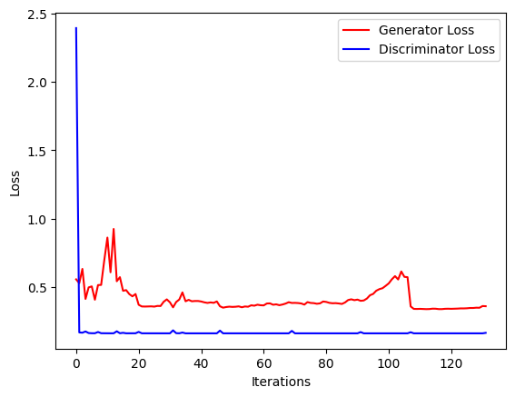
RESULTS
The generator and discriminator loss curves demonstrate the training progress.
Sampled colorized images showcase the effectiveness of the trained model in generating realistic and diverse colorizations for input grayscale images.
Evaluate the colorization quality based on visual inspection and potentially through user feedback or quantitative metrics.

Slide 15
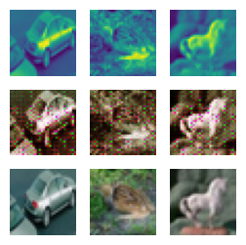
OUTPUT

Slide 16
CONCLUSION
In this project, we were successful in automatically color the gray scale images using Generative adversarial networks, to a visual degree which is acceptable. The images of CIPHER 10 with synthetic colors by GAN looked reasonably well and similar to the original images. There were some incidences where the model misunderstood the sea water for grass during the training process, but with further training, it was successful in coloring green color for grasses. We observed that the model faced unusual problem with red color, which it learnt after many epochs as compared to other colors.

Slide 17
REFERENCES
Nazeri, Kamyar, Ng, Eric, and Ebrahim, Mehran. "Image Colorization using Generative Adversarial Networks." arXiv preprint arXiv:1803.05400 [cs.CV] (2018).
Goodfellow, Ian, et al. "Generative adversarial nets." Advances in neural information processing systems. 2014.
https://medium.com/deep-dimension/gans-a-modern-perspective-83ed64b42f5c.
https://medium.com/@jonathan_hui/gan-whats-generative-adversarial-networks-and-its-application-f39ed278ef09.
https://www.oreilly.com/learning/generative-adversarial-networks-for-beginners.
https://becominghuman.ai/gans-the-art-of-creating-fakes-ab245a5a4aa1.
https://hackernoon.com/how-do-gans-intuitively-work-2dda07f247a1.
https://medium.com/nurture-ai/keeping-up-with-the-gans-66e89343b467.
https://towardsdatascience.com/generative-adversarial-networks-usingtensorflow-c8f4518406df.

